Slide 1
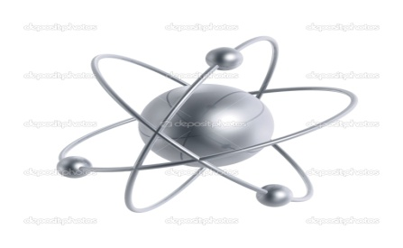
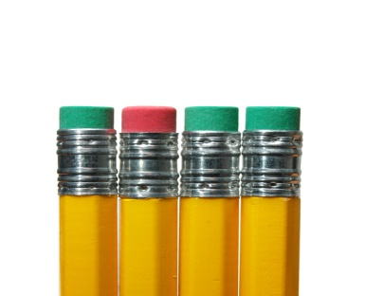
Today we will take notes about atomic structure and the arrangement of the periodic table! You will also need a book open to the periodic table, a calculator, and a sheet from the front ☺
Please have a pencil out and ready to fill in the blanks as we go along !

Slide 2
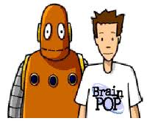
Let’s begin with a Brain Pop on atoms:
http://www.brainpop.com/science/matterandchemistry/atoms/

Slide 3
Everything is made up of atoms! Atoms are the smallest part of matter
But how did scientists come up with the theory of the atom?

Slide 4
So who was correct???
http://www.brainpop.com/science/matterandchemistry/atomicmodel/

Slide 5
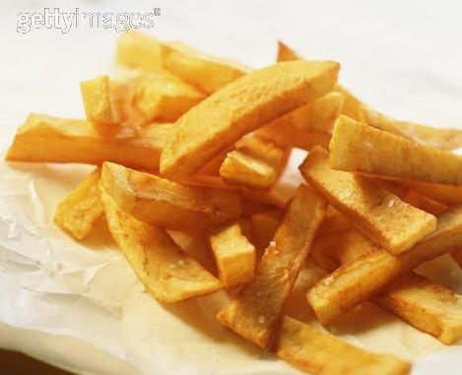
So how big is an atom??
100 million atoms lined up side by side would be about the width of a single french fry.

Slide 6
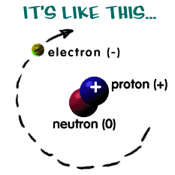
What are the three subatomic particles of an atom and their charges?
Protons are positive (+)
Neutrons are neutral (0)
Electrons are negative (-)

Slide 7
Relative
mass
Where
Found
Name
Symbol
Charge
Proton
p⁺
+1
1
Nucleus
Neutron
n⁰
0
1
Nucleus
Electron
e-
-1
0
In a cloud
^{Outside} the nucleus
Subatomic particles

Slide 8
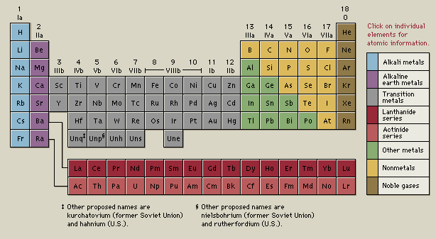
Let’s talk about the periodic table

Slide 9
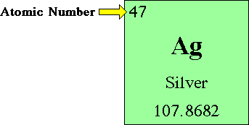
Atoms are arranged on the periodic table according to their number of protons or atomic number
The atomic number is the same as the number of protons in an atom.
The atomic number identifies the element.

Slide 10
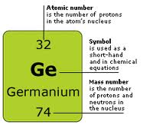
Looking at a periodic table, what is the atomic number for the following:
Carbon?
6, so carbon has 6 protons
Oxygen?
8, so oxygen has 8 protons
Iron? (Hint: Symbol is Fe)
26, so Iron has 26 protons

Slide 11
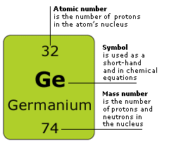
Mass number (also called atomic mass or atomic weight)
Mass # = # of protons + # neutrons
(most often they are the same)
We round this number sometimes

Slide 12
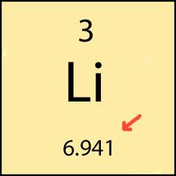
What is the atomic mass of the following elements?
Nitrogen?
14, so 7 protons, 7 neutrons
Neon?
20, so 10 protons, 10 neutrons

Slide 13
So how do we know the # of electrons?
*If an atom is not charged, then the number of electrons has to be the same as the number of protons!

Slide 14
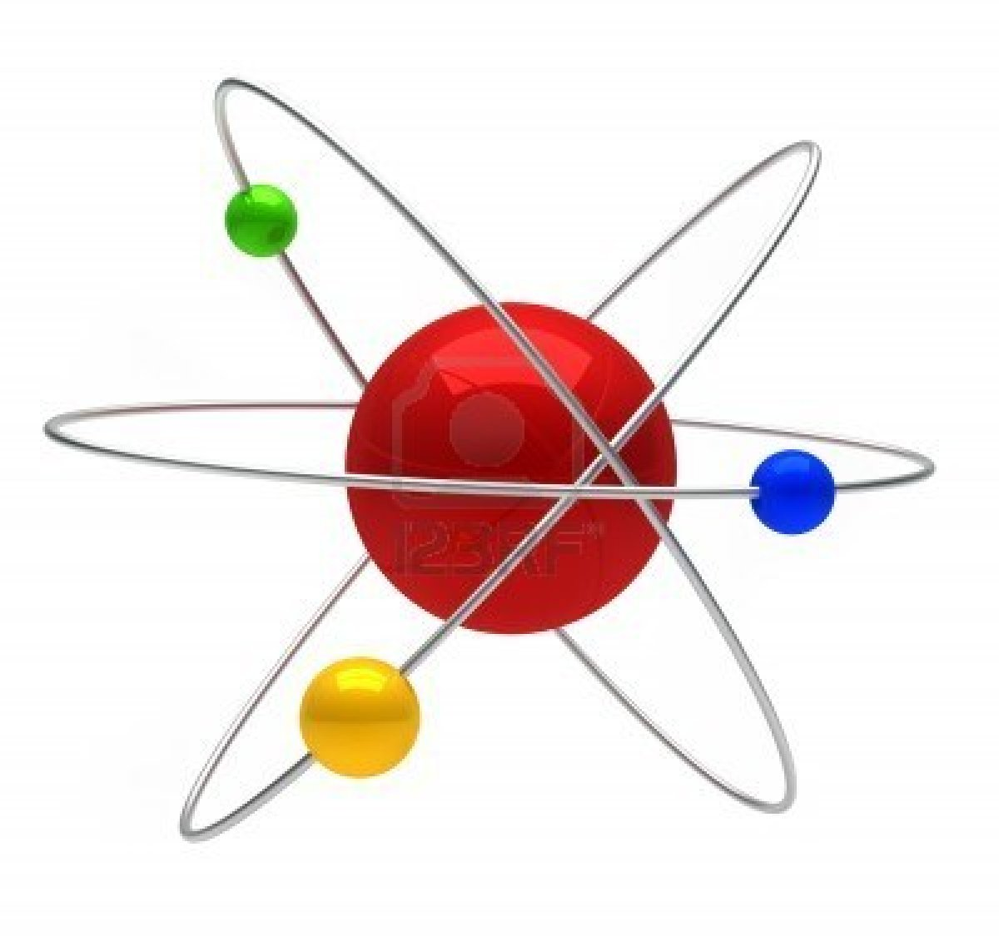
Complete the table GOING ACROSS at the bottom of your notes page.
Do this on your own and wait quietly for us to check it out together if we have time!

Slide 15
On the back..
Mg has an atomic number of 12, not 2.. It is cut off..
Iron is 26 not 6
Boron is 5

Slide 16
So let’s do some practice with what we have learned today!
http://www.learner.org/interactives/periodic/basics_interactive.html

