Slide 1
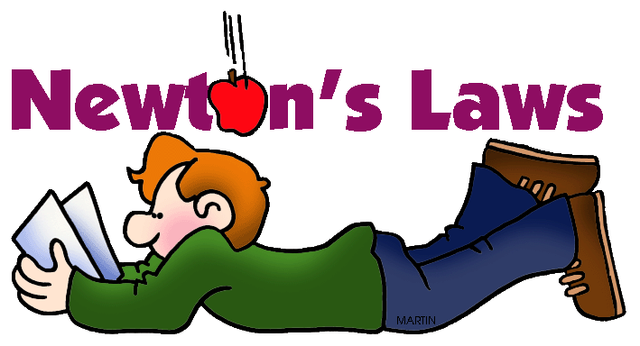
Activator
What do you remember about Newton’s 3 Laws of motion?

Slide 2
Newton’s Laws of Motion
SPS 8b. Apply Newton’s three laws to everyday situations by explaining the following:
Inertia
Relationship between force, mass and acceleration
Equal and opposite forces

Slide 3
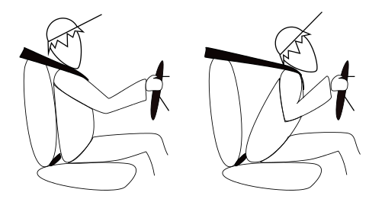
First Law (also called the Law of inertia)
Definition
Objects in motion stay in motion and objects at rest stay at rest until acted upon by an unbalanced force.

Slide 4
First Law
Example
A book sitting on a table will remain at rest until it is pushed or pulled (unbalanced force).
A passenger not wearing a seat belt in a car that comes to a sudden stop will continue moving forward until acted upon by an unbalanced force (the wind shield).

Slide 5
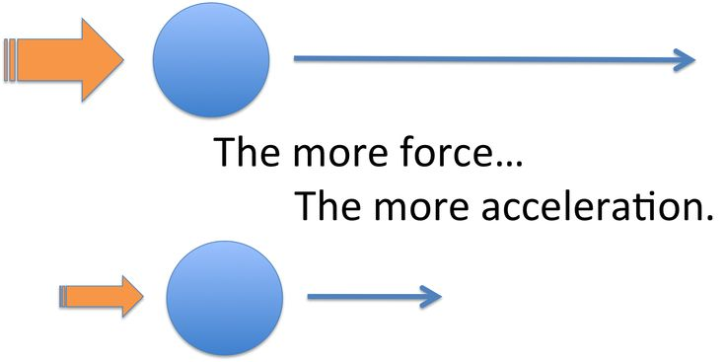
Second Law
Definition
It takes a unbalanced force to change an object’s motion.
Increased force causes an increased acceleration.
Increased mass causes a decrease in acceleration.
F = m × a

Slide 6
Second Law
Examples
You push a book sitting on a table causing it to move.
A baseball pitcher throws a 98 mi/hr fast ball with a great force.
The pitcher applies the same force on a bowling ball but it only moves 10 mi/hr.

Slide 7
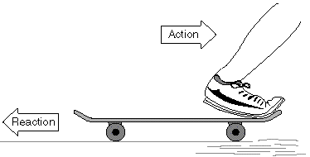
Third Law
Definition
For every action there is an equal and opposite reaction.

Slide 8
Third Law
Examples
You are sitting on a chair. Your weight is pressing down on the chair and the chair is pushing back with an equal and opposite force.
You step out of a boat onto a dock. You move forward but the boat moves in the opposite direction away from the dock.

Slide 9
Activator
Pick up a white board and briefly describe Newton’s 3 Laws in your own words

Slide 10
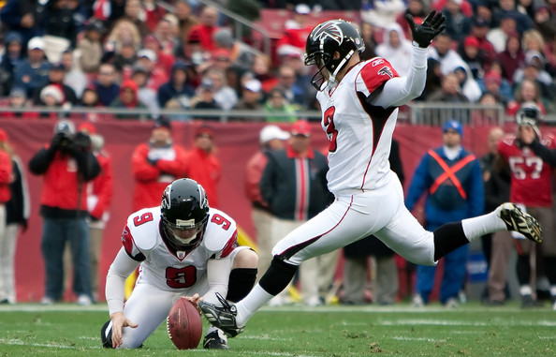
Newton’s 3 Laws Examples
Matt Bryant kicked the winning field goal for the Atlanta Falcons football game.
2nd

Slide 11
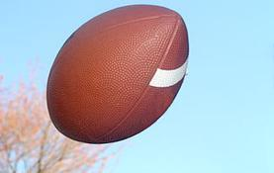
Newton’s 3 Laws Examples
After the kick by Matt Bryant, the football will fly through the air at a constant velocity, unless acted on by an outside force.
1st Law - Inertia

Slide 12
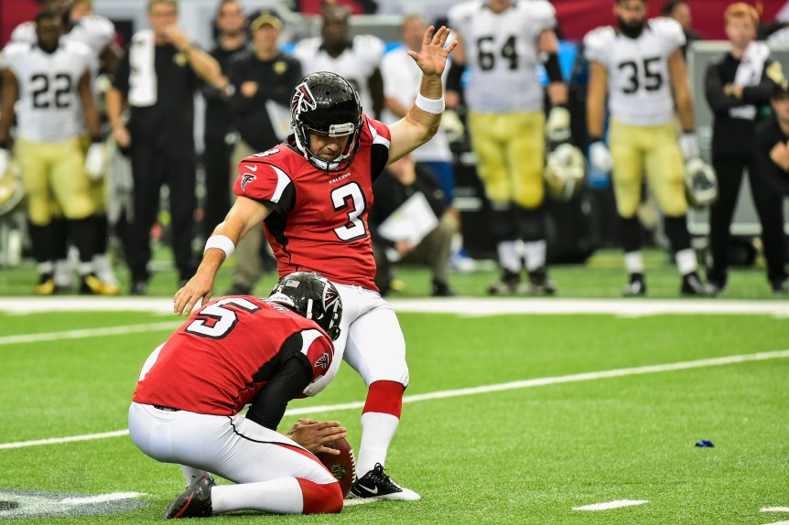
Newton’s 3 Laws Examples
The acceleration of the football is directly proportional to the amount of force acted on it by Matt Bryant.
2nd Law – a = F/m

Slide 13
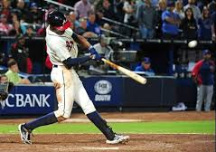
Newton’s 3 Laws Examples
A baseball player hits a homerun and the ball will continue through the air at a constant speed unless an outside force acts on it.
1st Law

Slide 14
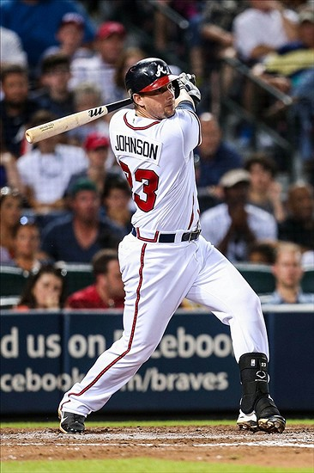
Newton’s 3 Laws Examples
A baseball player hits a homerun.
3rd Law

Slide 15
Newton’s 3 Laws Examples
The force that the baseball player applies on baseball causes the baseball to accelerate.
2nd Law

Slide 16
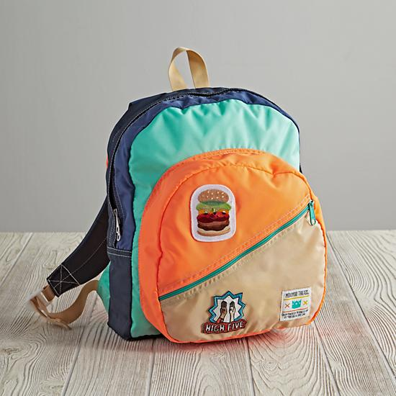
Newton’s 3 Laws Examples
Your bookbag is sitting on your desk and not moving.
1st Law

Slide 17
Newton’s 3 Laws Examples
You apply a force to your book bag and it causes the book bag to accelerate across the table.
2nd Law

Slide 18
Newton’s 3 Laws Examples
The book bag is applying a force on the table and the table is applying an equal and opposite force on the book bag.
3rd Law

Slide 19
Activator
Write down the definition of Newton’s Three Laws in your own words.

Slide 20
Which Law of Motion applies to the following?
The more force you apply to a cart the faster it accelerates.
2nd Law F = ma

Slide 21
Which Law of Motion applies to the following?
The higher the mass of an object the harder it is to accelerate.
2nd Law F = ma

Slide 22
Which Law of Motion applies to the following?
If you threw a ball in space it continue forever.
1st Law – in motion stays in motion

Slide 23
Which Law of Motion applies to the following?
When you make a right turn in your car and your body leans to the left.
3rd Law – Action/Reaction

Slide 24
Which Law of Motion applies to the following?
Blowing up a balloon and turning it loose.
3rd Law – Action/Reaction

Slide 25
Which Law of Motion applies to the following?
A car stops suddenly and you strain against your seat belt.
1st Law – in motion stays in motion

Slide 26
Which Law of Motion applies to the following?
Your friend is on a skate board, you push him and he moves forward.
3rd Law – Action/Reaction

Slide 27
Which Law of Motion applies to the following?
You push your friend on the skate board harder and he accelerates more.
2nd Law – F = ma

Slide 28
Which Law of Motion applies to the following?
Your friend on the skate board hits a curb and flies off of the skate board in the same direction as he was travelling.
1st Law – in motion stays in motion

Slide 29
Which Law of Motion applies to the following?
Matt Bryant of the Atlanta Falcons applied a force to a football causing it to accelerate for the winning field goal.
2nd Law – F=ma

Slide 30
Which Law of Motion applies to the following?
After the kick by Matt Bryant, the football will fly through the air at a constant velocity, unless acted on by an outside force.
1st Law – in motion stays in motion

Slide 31
Which Law of Motion applies to the following?
A baseball player hits a homerun and the ball will continue through the air at a constant speed unless an outside force acts on it.

Slide 32
Which Law of Motion applies to the following?
The force that the baseball player applies on baseball causes the baseball to accelerate.

Slide 33
Jan. 16, 2013
Think about Newton’s 2nd Law. On a sheet of paper, explain how force, mass, and acceleration are related.

Slide 34
Which of Newton’s Laws of Motion explains the following?
You apply your brakes to stop at a traffic light.

Slide 35
Which of Newton’s Laws of Motion explains the following?
A basket ball bounces off of the floor.

Slide 36
Which of Newton’s Laws of Motion explains the following?
Your lawn sprinkler has water coming out of the nozzles in one direction and the nozzles rotate in the opposite direction.

Slide 37
Which of Newton’s Laws of Motion explains the following?
You are riding a roller coaster. You suddenly start up a hill and you are pressed down into your seat.

Slide 38
Which of Newton’s Laws of Motion explains the following?
The positioning of football players – massive players are on the line and lighter players are in the backfield.

Slide 39
Which of Newton’s Laws of Motion explains the following?
You are sitting in your seat. You press down on the floor and the floor pushes back with an equal force.

Slide 40
Summary
On one piece of paper per group, write all of your team member names and what you will do to your balloon setup tomorrow to win.

Slide 41
Activator
What advice would you give someone to help them win balloon races?

Slide 42
Let the races begin!!

Slide 43
How do we use the Laws of motion to win balloon races?
When does the First Law of Motion Apply to your Balloon? (there are 2)
How does the Second Law of Motion apply to your balloon setup? (there are 3)
How does the third Law of Motion apply to your balloon? (there is at least 1)

Slide 44
Draw a force diagram for the situations below
A car engine is applying a forward force 400 N and the friction acting against the car is 400 N.
A car engine is applying a forward force 800 N and the friction acting against the car is 400 N.
A car engine is applying a forward force 200 N and the friction acting against the car is 400 N.

