Slide 1
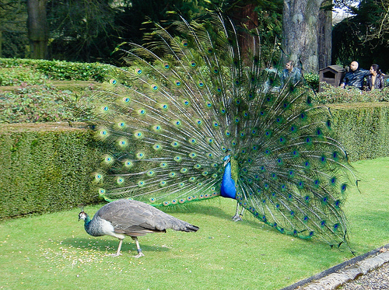
Evolution and Ecology
It is not the strongest of the species that survives, nor the most intelligent that survives. It is the one that is the most adaptable to change.
Charles Darwin

Slide 2
The Great Leap Forward
Starting in 1958, Mao Zedong, leader of the Communist Party of China, initiated a series of policies to transform the country into a modern, industrialized, communist society.
One of the first actions taken was known as the Four Pests Campaign.
This campaign sought to eliminate rats, flies, mosquitoes, and sparrows.

Slide 3
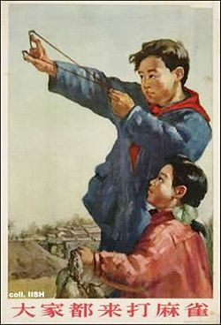
The Four Pests Campaign
Masses of people were mobilized to eradicate the Eurasian Tree Sparrow.
Tactics included:
Banging pots and pans, preventing the birds from landing, until they were exhausted.
Tearing down nests.
Shooting them from the sky using guns and sling shots.
“Everyone come and fight sparrows.”

Slide 4
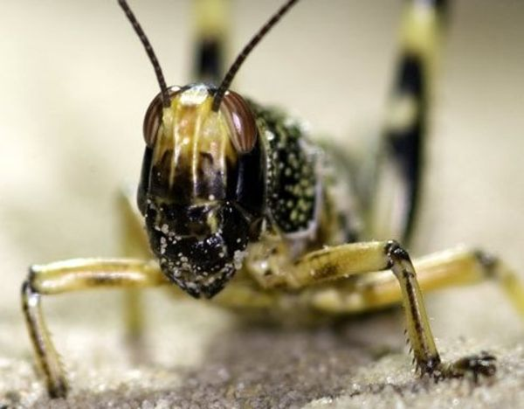
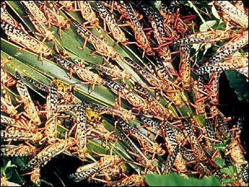
Unintended Consequences
The sparrows were hunted because they ate grain seeds; reducing crop yields.
By April of 1960, Chinese leaders came to realize that the sparrows also ate a large number of pest insects, including locusts.

Slide 5
Unintended Consequences
The government made a series of other poor agricultural decisions at this time, including:
Ordering farmers to increase the density of their planting by 6 times, believing that the same species of plant would compete with itself.
Deeper plowing of the soil, which brought up sand and rocks instead of more topsoil.

Slide 6
The Great Famine
The locust plague, overplanting, and overplowing combined with a severe drought.
The number of victims is unknown, but estimated between 20-43 million.

Slide 7
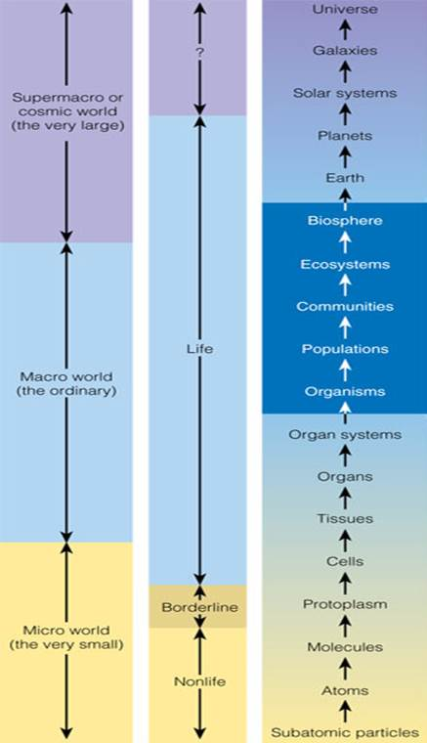
Ecology is the study of the interactions between living organisms and their surroundings, including their physical environment and other forms of life.
Ecology is only one part of the overall study of life, matter, and the universe.

Slide 8
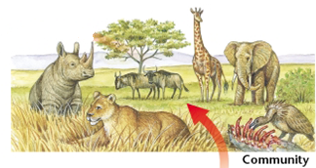
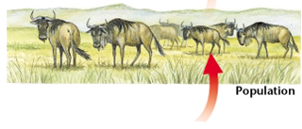
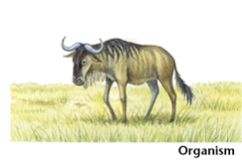
Organization of Life
An organism is an individual living thing.
A single species of organism is one that is similar enough to breed and produce healthy, fertile offspring.
A population includes all members of a species that live in the same area at the same time.
The biological community is made of all populations living and interacting in one area.

Slide 9
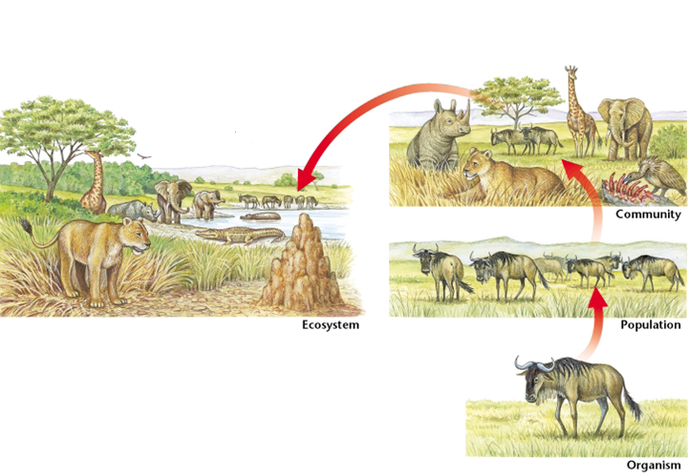
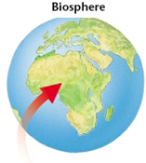
An ecosystem includes the biological community and its surrounding physical environment.
Nonliving factors like soil, precipitation, etc.
The biosphere is the part of Earth that supports life -- all ecosystems are found here.

Slide 10
Who Lives Where?
Each organism has a particular type of environment where it can survive. This is its habitat.
Habitats have a range of factors that influence the community that lives there – temperature, precipitation, etc.
Some organisms have a single critical factor that plays the greatest role in determining its range.
Critical factors have a “Goldilocks Effect”, meaning there can be too much or too little of it.

Slide 11
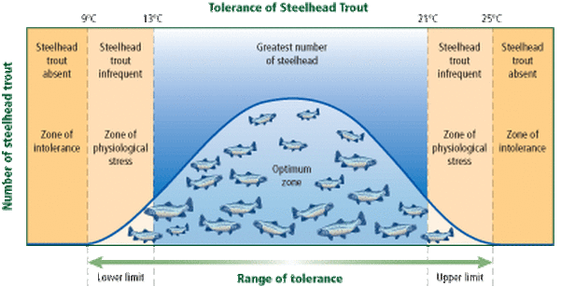
When the right level of an environmental factor is present, population levels will be growing or at their peak. This is the optimal range for that factor.
At the zone of physiologic stress, levels of the factor are too high or too low. The population barely survives.
At the zone of intolerance, the population dies out.

Slide 12
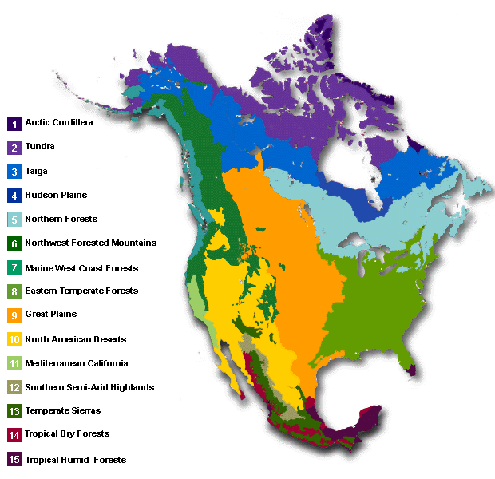
Why do coniferous trees have such a wider range (3,5,6,7,8) than broadleaf deciduous trees (8)?
Why are broadleaf trees more prevalent than coniferous trees in areas where they can both survive?

Slide 13
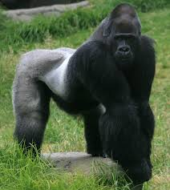
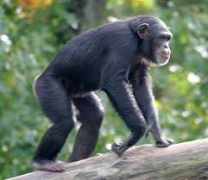
Adaptations
The range of tolerance for a species is largely defined by the presence of physical, behavioral, or physiologic adaptations.
Physical adaptations are structural differences in coloration, body shape, musculature, etc.
Behavioral adaptations include migration, or marking a territory.
Physiologic adaptations, such as skin tanning, occur at the cell or tissue level in an organism.
The gorilla is adapted for living and feeding on the ground, while chimpanzees gather food from trees.

Slide 14
Evolution
All of the unique adaptations found in different organisms are the result of evolution -- small, advantageous mutations that have accumulated over countless generations.
Natural Selection describes the process where individuals with better genes survive and reproduce more successfully, while those with weaker genes do not.
The primary source of this genetic variety is random mutations. These are small changes of DNA.
Usually these changes produce no effects or bad ones, but occasionally, they can be beneficial.

Slide 15
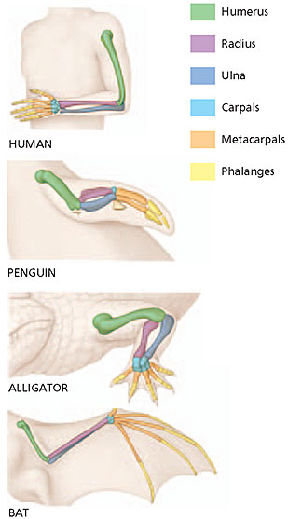
Evolutionists will cite three categories of evidence in support of the theory.
Physical Similarities
Most animals have similar bones in their limbs (fins, arms, wings).
These similarities can also be found between living species and fossils.
Comparing DNA
Chimpanzees, bonobos, and humans share about 99% of the same DNA.
Vestigial Structures
Still exist in the body but are no longer needed
Ex: Appendix, wisdom teeth

Slide 16
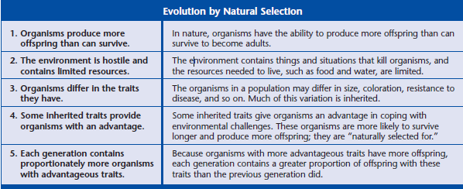
Natural Selection

Slide 17
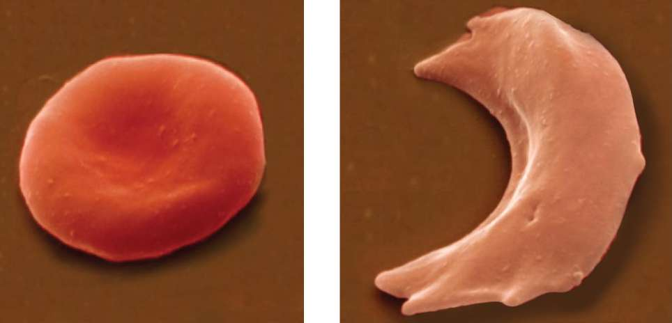
An example of natural selection in the human race can be seen in sickle-cell anemia.
Normal red blood cells have a biconcave –disc shape.
Sickle-shaped red blood cells are the result of a single mutated gene.
Sickle cells can get stuck in small blood vessels, causing tissues to become oxygen-deprived.

Slide 18
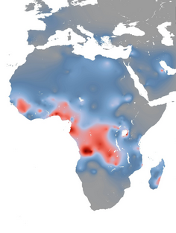
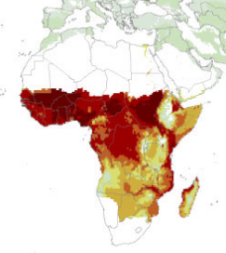
Individuals with sickle-cell anemia or carriers are also highly resistant to malaria.
The mutation is a disadvantage in climates where malaria is absent due to the long-term health issues.
The mutation is an advantage in climates where malaria is present due to the resistance it provides.
Sickle cell gene frequency in Africa. Source: University of Oxford study.
Distribution of malaria transmission in Africa. Source: American Journal of Tropic Medicine and Hygeine Study.

Slide 19
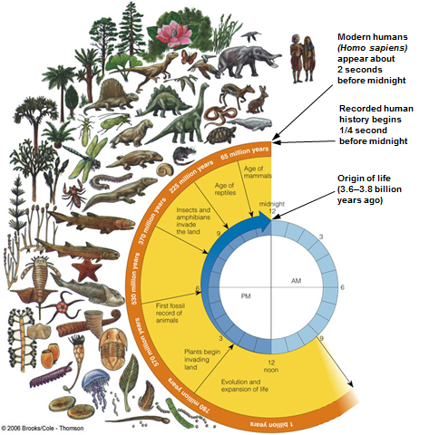
Evolution is an very slow process.
Current life on Earth represents billions of years of small mutations and natural selection.

Slide 20
Speciation
Over a long enough period of time, enough mutations occur that a new species emerges.
When a population splits and become two different species, it is called divergent speciation.

Slide 21
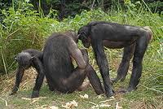
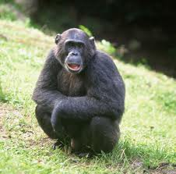
Chimpanzees and bonobos are very closely related primates, with only a few differences between the species.
They likely diverged during a severe drought millions of years ago.

Slide 22
Encouraging Natural Selection
Four ecological factors will “encourage” natural selection to favor certain individuals in a population.
Speciation is more likely to occur.
Physiological stress, inappropriate levels of a critical environmental factor.
Moisture, Light, pH
Predation, when one organism is hunted and killed by another.
Competition, the result of other organisms attempting to use same resources.
Sexual Selection occurs when the female (usually) responds to specific behaviors or physical traits.

Slide 23
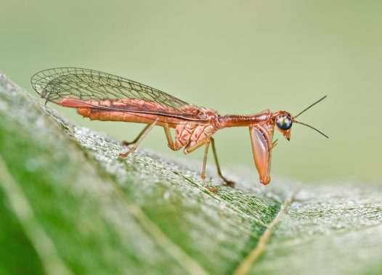
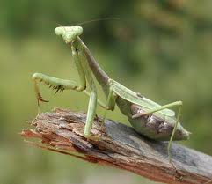
Convergent speciation can occur when natural selection favors unrelated organisms to evolve to look similar.
Mantis Fly
Preying Mantis

Slide 24
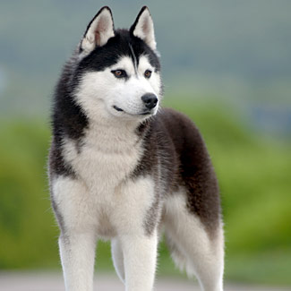
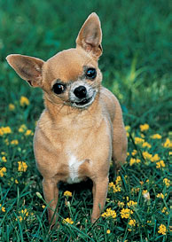
Artificial Selection
The selective breeding of organisms by humans for characteristics desirable to them.

Slide 25
Biodiversity
Evolution has produced a tremendous amount of biodiversity on Earth.
Biodiversity is defined as the number of different species within an ecosystem or area.
The number of species is unknown.
About 1.5 million have been identified.
A recent study estimates 8.7 million exist currently.

Slide 26
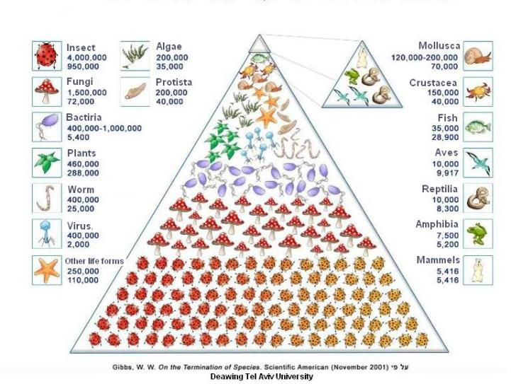
The majority of known species are insects, followed by fungi and bacteria.

Slide 27
The Taxonomic Naming System
With the tremendous diversity of living organisms, a system was devised to organize them based on their interrelatedness.
Domain
Kingdom
Phylum
Class
Order
Family
Genus
Species

Slide 28
Human Classification
 | Taxon | Reason
Domain | Eukarya | Cells have nuclei and organelles (eukaryote).
Kingdom | Animalia | Multicellular. Unable to produce own food (heterotrophic).
Phylum | Chordata | Have a nerve cord along the back.
Class | Mammalia | Warm-blooded, gives birth to live young, has hair.
Order | Primates | Forward-facing eyes, enlarged brains, vertical posture.
Family | Hominidae | Capacity for language, culture, empathy.
The final two taxa, genus and species, are used to define the species’ scientific name.
Homo sapiens
Italicized or underlined
Genus capitalized, species lower-case.

Slide 29
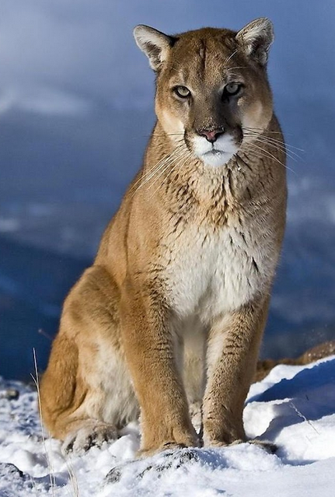
The scientific naming system is important, as many species have multiple common names.
The cougar holds the Guinness world record for number of common names, with 40 in English alone!
Cougar, catamount, painter, panther, ghost cat, puma, shadow cat, mountain lion, deer tiger, devil cat, sneak cat, plain lion, fire cat, mountain screamer, Florida panther, silver lion……
Puma concolor

Slide 30
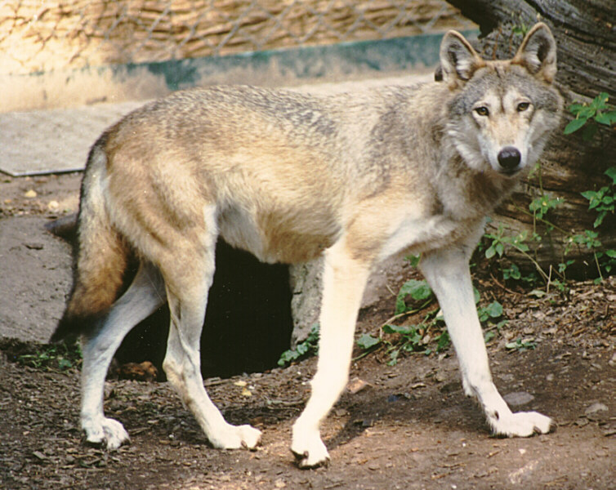
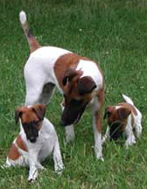
Two animals with many classification levels in common are considered very closely related – they diverged recently.
Wolves and dogs share the same domain, kingdom, phylum, class, order, and family.
Canis lupus lupus
European Wolf
Canis familiaris
Domesticated dog

Slide 31
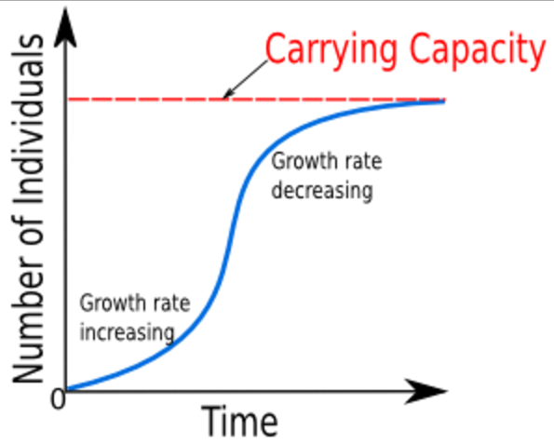
Population Growth Patterns
As their ecosystem and community change, populations of organisms undergo different growth patterns.
The most common growth pattern is called logistic growth, which takes the shape of an “S”.

Slide 32
Logistic growth starts off fast, but gradually slows down as the population encounters environmental resistance.
Environmental resistance can come in two forms:
Density-dependent factors, such as disease, which affect dense populations more.
Density-independent factors, such as natural disaster or climate change, which similarly affect all populations.

Slide 33
The density-dependent growth-limiting factors will cause the population’s growth to slow and eventually stabilize.
The point at which it stabilizes is the carrying capacity, or the maximum population size that can be sustained by the ecosystem.

Slide 34
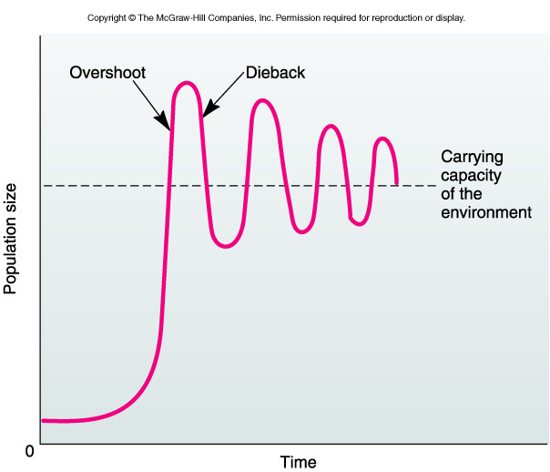
Exponential growth, which takes the shape of a “J”, does not experience growth-limiting factors.
The population will continue to grow, eventually exceeding the carrying capacity.
This is called an overshoot.
When a population overshoots the carrying capacity, it experiences a dieback, often in the form of mass-starvation.
Exponential growth is unusual, and does not typically occur under normal conditions.

Slide 35
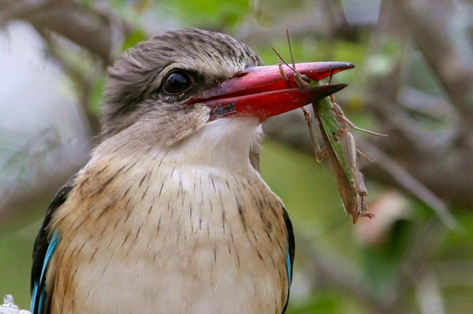
The Great Famine
China’s great famine in 1958 was partially due to the removal of a density-dependent growth limiting factor for locusts – the predatory Eurasian tree sparrow.

Slide 36
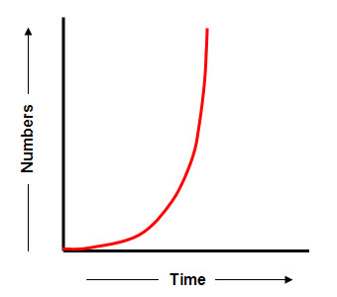
Locusts were able to grow exponentially, creating swarms with millions of individuals.

Slide 37
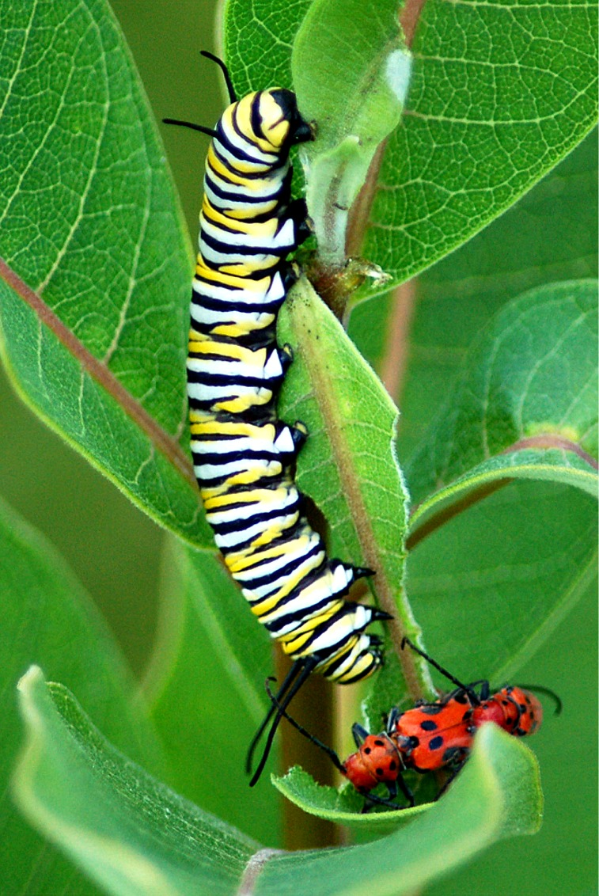
Community Interactions
How quickly populations grow and the maximum size they attain are often the result of interactions with other populations of organisms.
One of the most basic interactions is predator-prey, where one organism consumes the other.

Slide 38
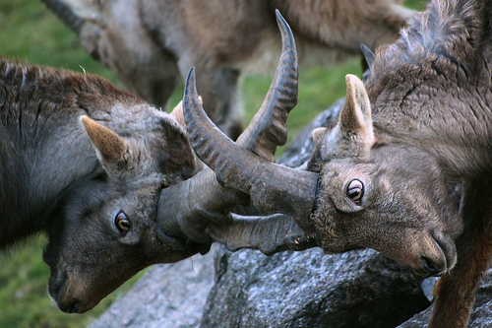
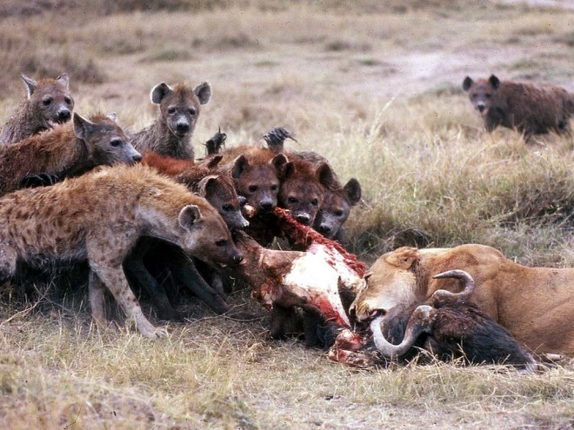
Competition, where organisms and populations compete for resources, is another common interaction.
Water, food, territory, mates.
When the competition occurs within members of the same species, it is called intraspecific.
When the competition occurs between different species, it is called interspecific.

Slide 39
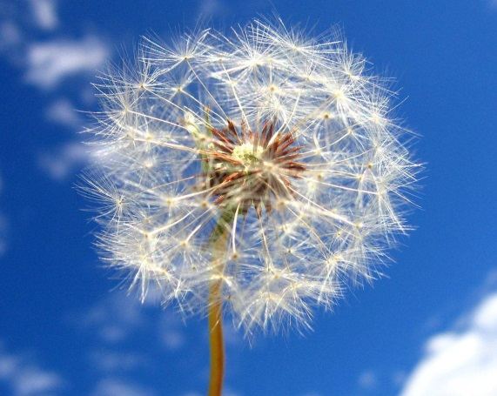
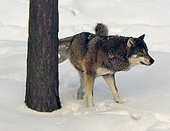
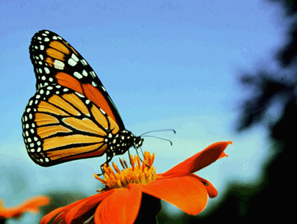
Some organisms have developed adaptations to avoid directly competing with their own species.
Plants will send their seeds far away to avoid sharing the same soil.
Wolves mark and occupy a territory so they have enough hunting area.
Adult monarch butterflies and their caterpillars each utilize a different part of plants.

Slide 40
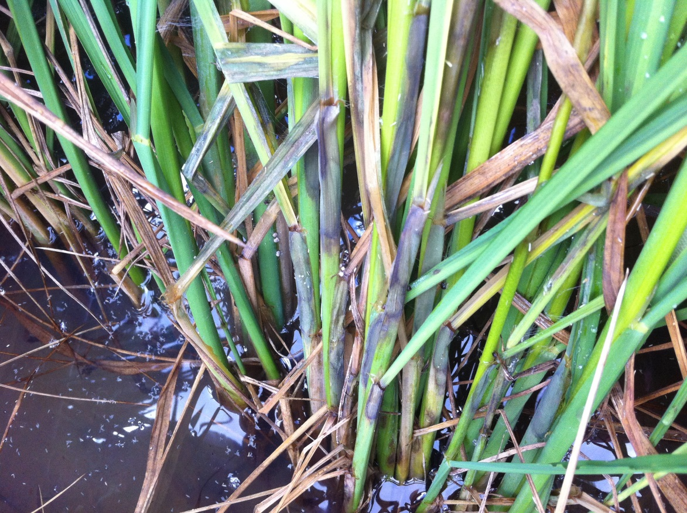
The Great Famine
Another significant cause of the great famine was planting too densely. This caused the rice plants to compete with each other directly for water and soil nutrients.

Slide 41
Symbiosis
The closest relationships of all are symbiosis. These involve a lot of close contact between two species.
When the relationship benefits both organisms, it is called mutualism.
When one organism benefits while the other is unaffected, it is called commensalism.
When one organism benefits at the expense of the other, it is called parasitism.

Slide 42
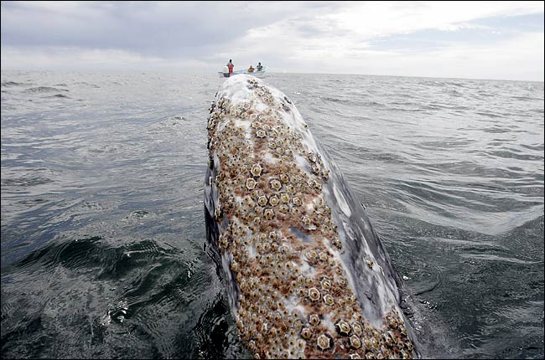
Barnacles create homes by attaching themselves to whales. The whales are unaffected.

Slide 43
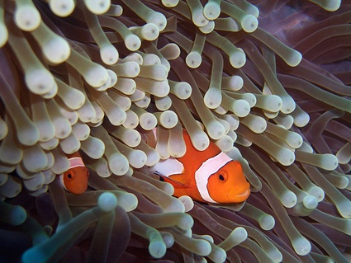
Clownfish have a mucus coating that allows them to live in sea anemones. Their presence attracts other fish for the anemone to eat.

Slide 44
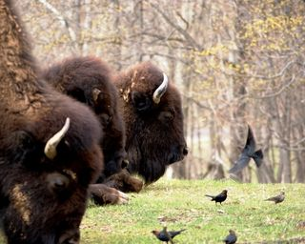
As bison walk through grass, insects are disturbed and fly away. They are eaten by cowbirds.

Slide 45
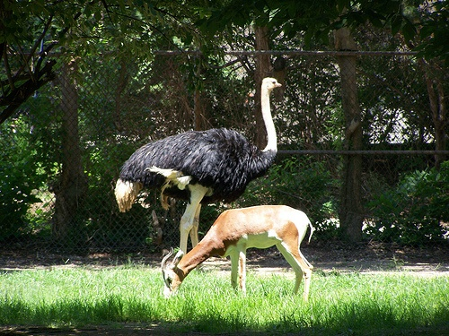
Ostriches and gazelles feed next to each other. Ostriches have excellent eyesight, while gazelles have stronger senses of hearing and smell.

Slide 46
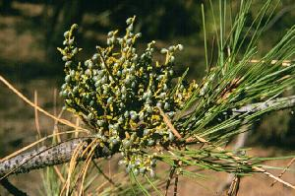
Mistletoe extracts water and nutrients from the spruce tree directly.

Slide 47
Today, textbooks in China omit discussion of the true causes of the famine, instead citing “three years of difficulty” caused by “bad weather.”
Mao Zedong’s portrait still hangs at the center of Tiananmen Square.

